Slide 1
Capstone Project - EDA Hotel Booking Analysis
Team Members
Mohit Jain ,
Chetan Patil ,
Rajesh Patil ,
Siddharth D Choury

Slide 2
What is Exploratory Data Analysis
Exploratory Data Analysis is one of the most efficient method used to Analyse the given data sets , Using the exploratory data analysis we can summarize the characteristics of the data sets which are important and in this EDA Capstone Project we have made use of the statistical graphs and the other visualization methods

Slide 3
Basic Steps Involved in Exploratory Data Analysis
Collection of Data : Data Collection Stands out to be significant as its important for Exploratory Data Analysis .
Data Cleansing :In this method we have removed the unwanted and the irrelevant information from the given data set.
Data Visualization: In this method we have used various plot, graphs, etc. to represent data in readable format.
Interpretation: This is the important step which is data providing insightful for business decisions.

Slide 4
EDA on Hotel Booking Analysis.
The given data set consist of the information regarding the type of the hotel and the different variable with respect to characteristics as ( length of Stay , Adults , Children , parking spaces etc.) Personal Identifying information has been eliminated from the data sets for user privacy. In this study we are about to explore the factors influencing /governing the booking of the Hotel

Slide 5
Steps Involved in EDA Project
The Project is been Dealt with 3 Simple Steps
1. Initialization ( Pre –Processing, cleaning and data wrangling)
2. Performing the Exploratory Data Analysis on pre-processed data Set.
3. Analysing and Interpreting the given data sets and by framing valuable observation/quarry and then interpreting out the conclusion for tacking business decision.

Slide 6
Bird Eye View – Characteristics of Data
Defining the Characteristics of the Data Points
1. hotel : Defines the Type of the Hotels in the Given Data Set of Hotel Booking Analysis (Resort hotel and City hotel)
2. is_canceled: Defines the Status of the Booking ( Ex: Cancelled )1 refers to Canceled and 0 suggests Not Canceled
3. lead_time: Gives us the timing difference between the booking Time and the arrival from the given data set
4. arrival_date_year : Represents the Year of Arrival of the Visitor (2015, 2016, 2017)
5. arrival_date_month: Represents the month of Guest ( Visitors ) Arrival From Jan To Dec
6. arrival_date_week_number: This represents the Week No. of The Visitors Arrival - 1 to 53
7. arrival_date_day_of_month: This gives the day number of month when the visitor arrived - 1 to 31
8. stays_in_weekend_nights: This gives the number of weekend nights, i.e. Saturday and Sunday

Slide 7
9. stays_in_week_nights: This gives the number of week nights, i.e. Monday to Friday
10. adults: This gives the number of adults per booking
11. children: This gives the number of children per booking
12. babies: This gives the number of babies per booking
13. meal: This gives the type of meal preferred.
Undefined/SC means no meal package, BB means Bed & Breakfast, HB means Half board (i.e., breakfast & one other meal – usually
dinner), FB means Full board (i.e., breakfast, lunch & dinner)
14. country: This gives the country of origin of visitor
15. market_segment: This gives the group of people based on market
Direct, Corporate, Online TA, Offline TA/TO, Complementary, Groups, Aviation Where, TA: Travel Agents, TO: Tour Operators
16. distribution_channel: This mentions the type of distribution channel
Direct, Corporate, TA/TO, Undefined, GDS Features (cont.):
17. is_repeated_guest: This shows repeated customers 1 means repeated customer, 0 means not repeated

Slide 8
18. previous_cancellations: Represents the number of previous bookings that were cancelled by the customer before the current booking
19. previous_bookings_not_canceled: Represents the number of previous bookings not cancelled by the customer prior to the current booking
20. reserved_room_type: Represents the type of room reserved 'C', 'A', 'D', 'E', 'G', 'F', 'H', 'L', 'P', 'B'
21. assigned_room_type: Represents type of room whose possession is given at the time of arrival. 'C', 'A', 'D', 'E', 'G', 'F', 'H', 'L', 'P', 'B'
22. booking_changes: Represents the number of bookings changed
23. deposit_type: Represents the types of deposit No Deposit, Non Refund, Refundable
24. agent: Represents the Agent Id
25. company: Represents the Company Id
26. day_in_waiting_list: Represents the Number of days the booking was in the waiting list before confirmation
27. customer_type: This Gives us Type of customer Contract, Group, Transient, Transient-party
28. adr: means average daily rate
29. required_car_parking_spaces: Number of car parking spaces required by the customer
30. total_of_special_requests: Number of special requests made by the customer
31. reservation_status: Status of reservation Canceled, Check-Out, No-Show
32. reservation_status_date: Date at which the last status was updated

Slide 9
Formulated Observation used for EDA.
1. To Identify the type of the Hotel having the Maximum Booking .
2. To Identify the Country having the Maximum Booking
3. To Identify Year Wise Booking Status of Hotel Category
4. To Identify Year Wise Booking Status of Hotel Category – Segment-wise
5. To Identify the Monthly Booking Analysis Status ( Max and Minimum Bookings )
6. To Identify the Type of Hotels Preferred by the Visitors
7. To Identify the Visitor Retention Rate of Hotel Booking
8. To Identify the Cancellation Status after the Booking
9. To Analyse the Lead time
10.To Identify the Average Daily Rate – Market Segment Wise
11. To Analyse the Visitors Preference of Stay ( Weekdays or Weekend )
12. To Analyse the Year Wise Waiting Analysis
13. To Analyse which type of meal is preferred by visitor while booking.

Slide 10
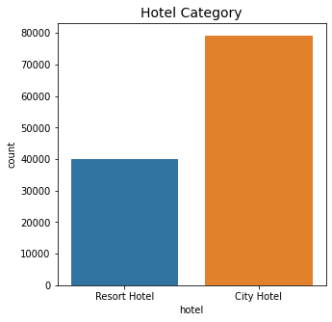
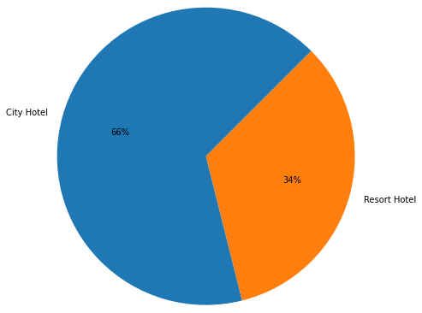
Data Representing the Type of the Hotel Preferred
Interpretation-The Above Chart Represents the Type of the Hotel Preferred by the Visitors , after analysing the given data set we can conclude that 66% of the visitors prefer the City Hotel as compared to 34% of the Visitors who are inclined towards the Resort Hotel.

Slide 11
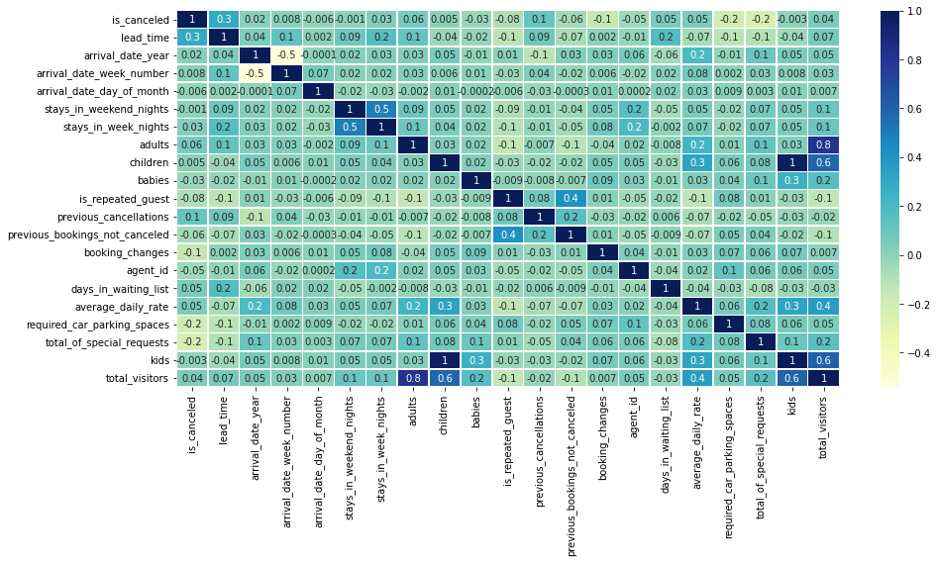
Heat Map Showing the Correlation Between Given Data Sets
Interpretation :- As per the Heat map it is clear that there is no such strong correlation between each variable of data set. All data set variable is independent of each other.

Slide 12
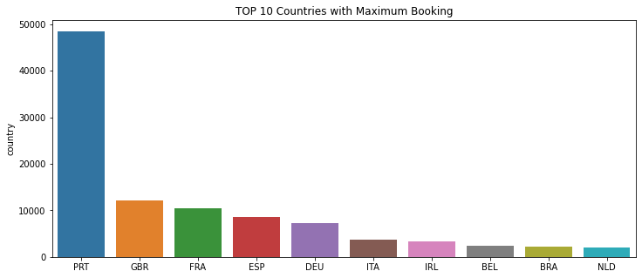
Data Representing the Countries wise Booking Status
Interpretation-The Above Chart Represents the Country having Maximum Bookings , As per the given data set . Portugal is the country which has close to 50000 Bookings . There is a significant difference between booking status when compared the other countries. Portugal is having maximum bookings followed by the Great Britain with 10000+ , France , Spain etc.

Slide 13
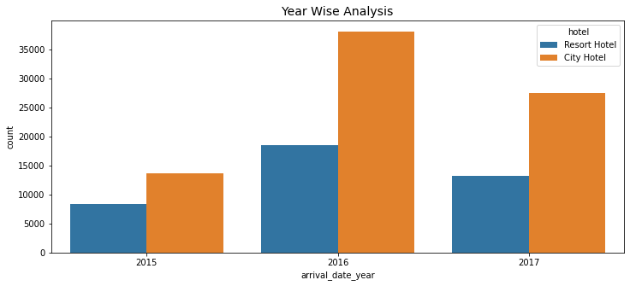
Data Representing Year Wise Booking Status
Interpretation-The Above Chart Represents the Type of the Hotel Preferred by the Visitors , The given graph is and Year wise comparison , where in we can find in 2016 , the bookings were maximum as compared the to year 2017 and 2015 , With Year 2015 saw the least number of bookings as compared to the other two years

Slide 14
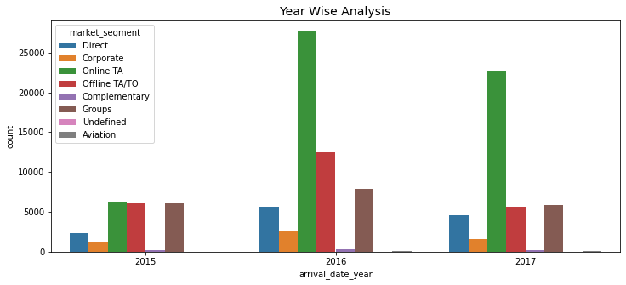
Data Representing Yearly Booking Status – Segment Wise
Interpretation-The Above Chart Represents the Yearly booking status as per the Market Segment , from the graph we can clearly see that the Corporate and Direct Consumers are having the least share as compared to the Online TA and Offline TA/TO

Slide 15
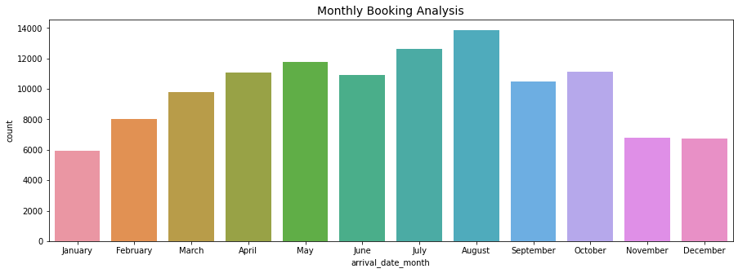
Data Representing - Monthly Booking Analysis
Interpretation-The Above Chart Represents the Monthly Booking Analysis of the Hotel , August month shows the maximum booking , and January month shows the least booking .

Slide 16
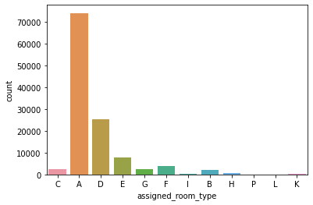
Data Representing the Room Type Preferred by the Visitors
Interpretation:- From the Above graph we can clearly conclude that Room ‘A’ is preferred most of the time by the visitors followed by Room D and Room E.

Slide 17
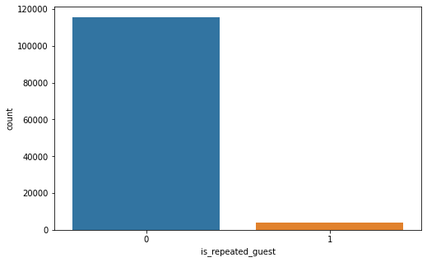
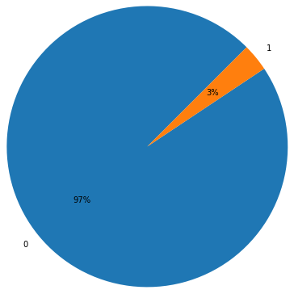
Data Representing The No. of Repeating Customers
Interpretation: This data represents the No. of the customers repeated , as from the graph it clearly indicated that 97% of the times the customers are not repeated and only 3% of the people come under the category of the repeated guest .

Slide 18
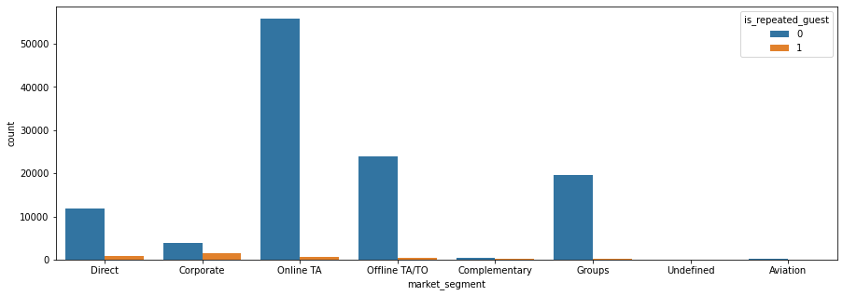
Data Representing Repeated Guest – Segment Wise
Interpretation : From the Above chart we can conclude that , Repeated Guest are mostly falling under the category of corporate segment followed by Direct and Online /Offline TA/TO . Where as Undefined and Aviation don’t have repeated Guest.

Slide 19
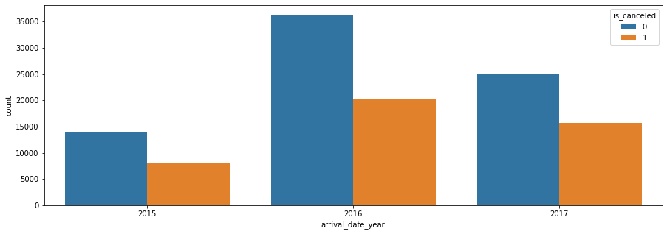
Data Representing Cancellation Status after Booking
Interpretation: The above graph represents the cancellation happened after the booking , Year 2016 and 2017 , shows the maximum booking cancellation , and the least cancellations were happened in the year 2015.

Slide 20
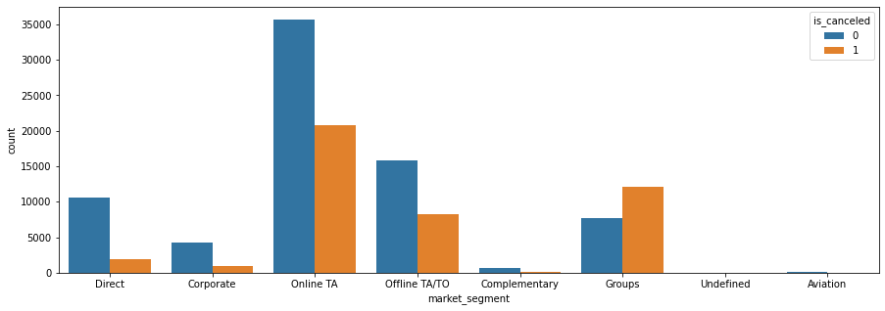
Data represents the cancellation happened after the booking – Segment Wise
Interpretation: The above graph represents the cancellation happened after the booking , according to the segment , Online TA and Offline TA followed by the Groups forms the basis for the maximum cancellations.

Slide 21
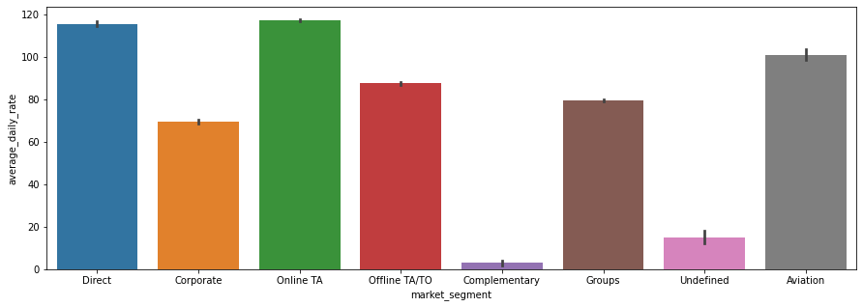
Graph Representing the Average Daily Rate
Interpretation : This graph represents the Average Daily rate according to the market segment , where Direct and Online TA forms the basis for maximum Average rate and Complementary are the least .

Slide 22
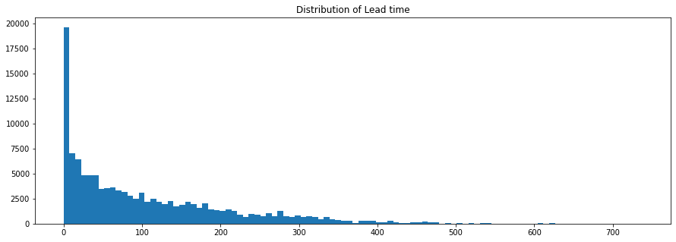
Data Chart Representing the Lead time Distribution
Interpretation :The above graph represents the Lead time of Booking. Mostly we don’t have to wait for the hotel booking but some hotel required very much time to booking.

Slide 23
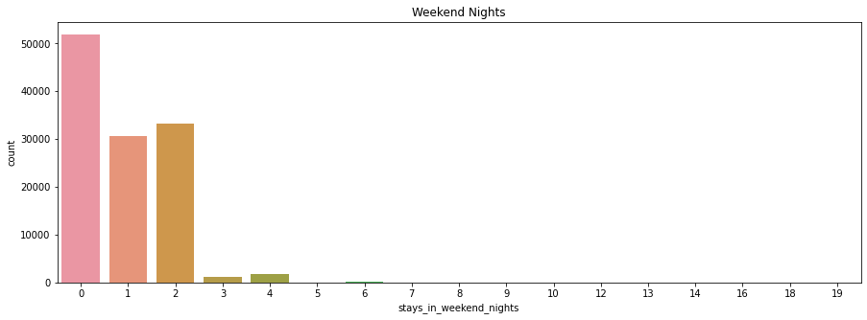
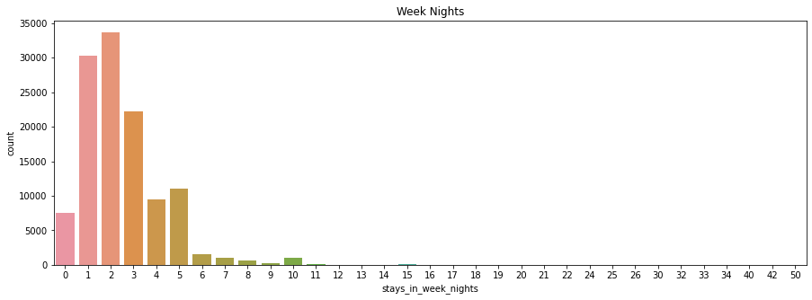
Data Representing Visitors Preference to stay
Interpretation : - The above graph represents the visitors preference of stay , maximum of the visitors like to stay for 0 - 2 days only and rest do not prefer to stay for a longer duration

Slide 24
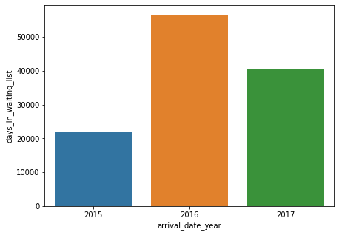
Data Representing the Waiting Time Period – Year wise
Interpretation : The above graph represents the waiting period according to the year , we can clearly conclude that year 2016 has a maximum waiting period and year 2015 with the least waiting period.

Slide 25
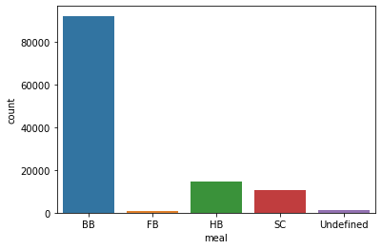
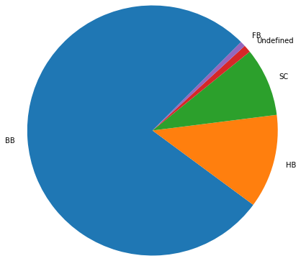
Analysed type of Meal preferred by Visitor.
Interpretation : The above graph represents that break fast meal is most preferred while selection and booking hotel.

Slide 26
The Conclusive Findings of the Study
we can conclude that 66% of the visitors prefer the City Hotel as compared to 34% of the Visitors who are inclined towards the Resort Hotel.
City hotels are most busy hotels all the years and in 2016 it’s on peak around 40000 customer booked city hotel
Portugal is having maximum bookings followed by the Great Britain with 10000+, France, Spain etc.
Majority of booking happed through online travel agent so we can provide great offers to TA
Analyzing Market Segment wise Average Daily Rate and found that
August month has the maximum booking, and January month has the least booking number and majorly room type ‘A’ preferred by customers and room type ‘P’,’L’,’K’ is less preferred by customers with type of meal as breakfast.
One of our analyses showing many customers are not go repeat to same hotel only 3% retention rate of hotels.

Slide 27
THANK YOU

